Slide 1
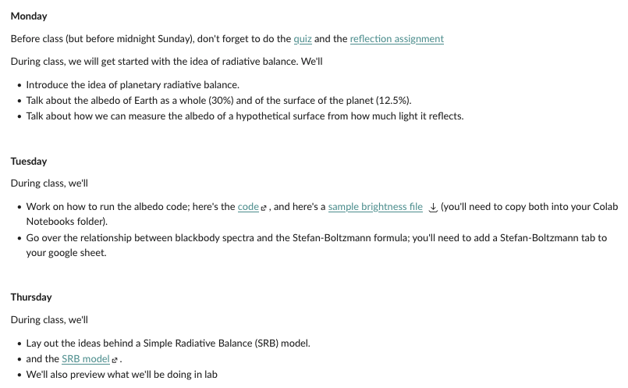
Roadmap (from Canvas)

Slide 2
Getting started with albedo.ipynb
Go to the code and make a copy in your own Colab Notebooks folder
Move green3.jpg into the the Colab Notebooks folder
Run the code (“Runtime/Run all”) and scroll down to 3rd code block: Calculating albedos

Slide 3
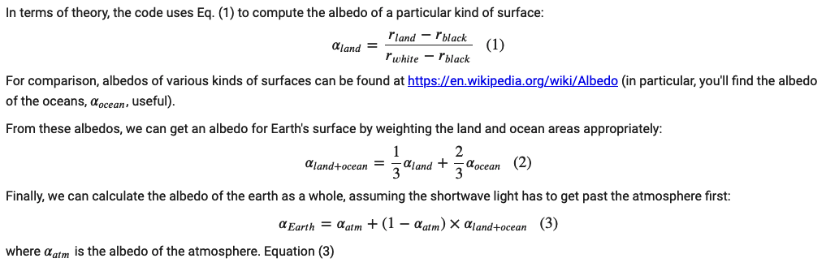
Equations 1-3 in albedo.ipynb

Slide 4
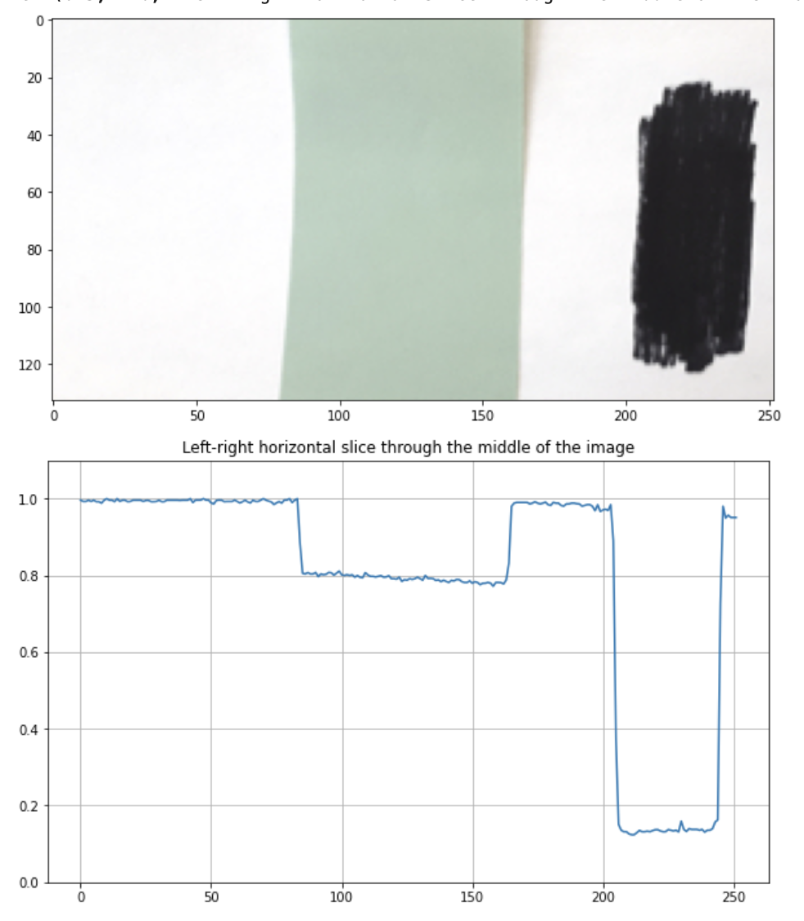
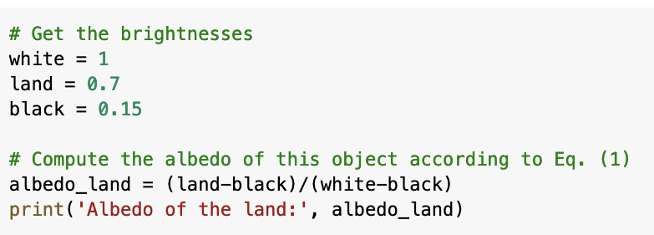
Using Eq. (1)
You’ll need to fix one of these values
What value of albedo do you get?

Slide 5
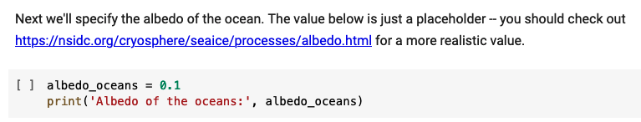
Specifying the albedo of the oceans

Slide 6
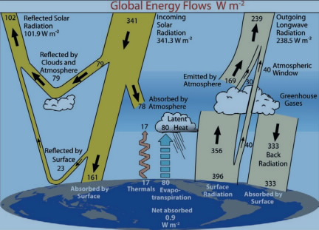

Calculating the albedo of the atmosphere

Slide 7
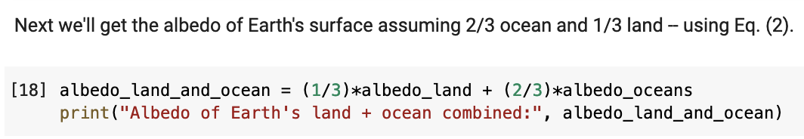
Using Eq. (2)
What do you get?

Slide 8
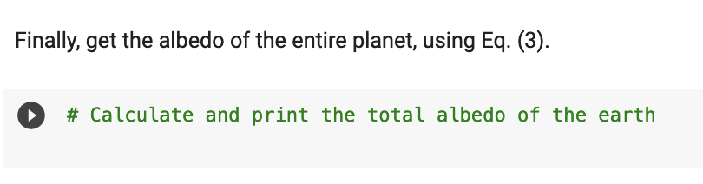
Using Eq. (3)
You won’t get the known value of 0.3 (30%) because the entire earth’s surface is not that green stuff. But what do you get?

